Slide 1





Hunting Stalkerwares
for Fun
Abhinand N
Lead Mobile Security Engineer
Traboda CyberLabs

Slide 2

About me
https://bx1n.github.io/
Undergraduate degree from Amrita Vishwa Vidyapetham, Amritapuri
amFOSS Alumni
National University of Singapore
Amrita Center for Cybersecurity Systems and Networks
Lead Mobile Security Engineer, Traboda
Speaker at BlackHat Arsenal Europe & MEA

Slide 3

Stalkerware?

Slide 4
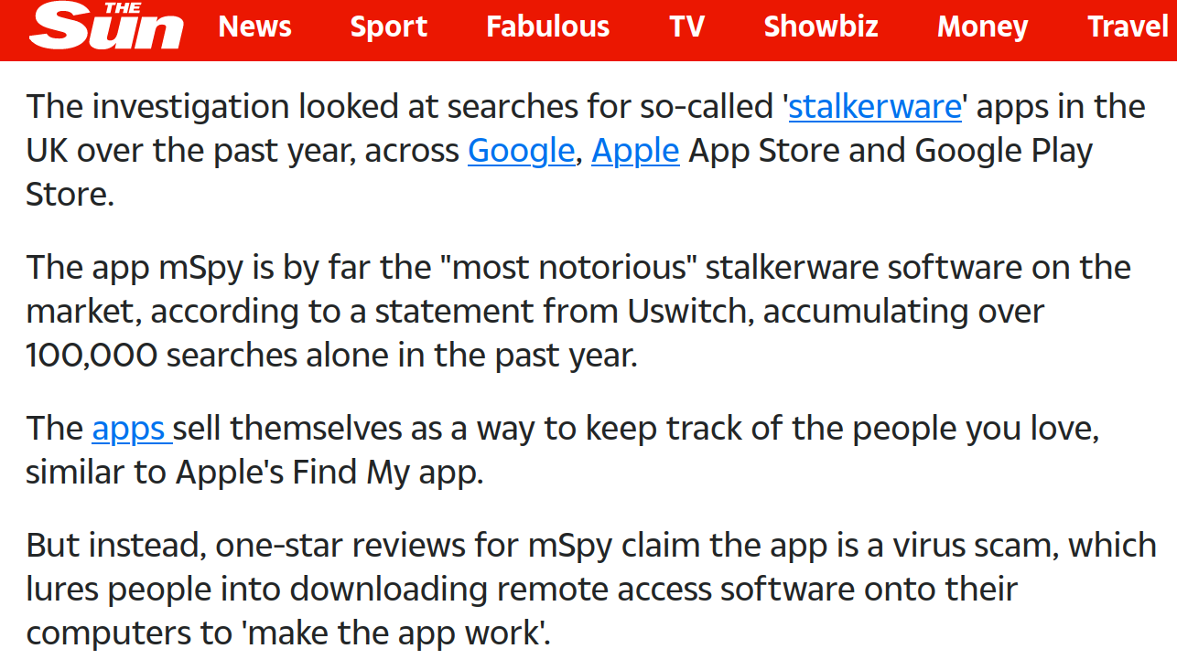
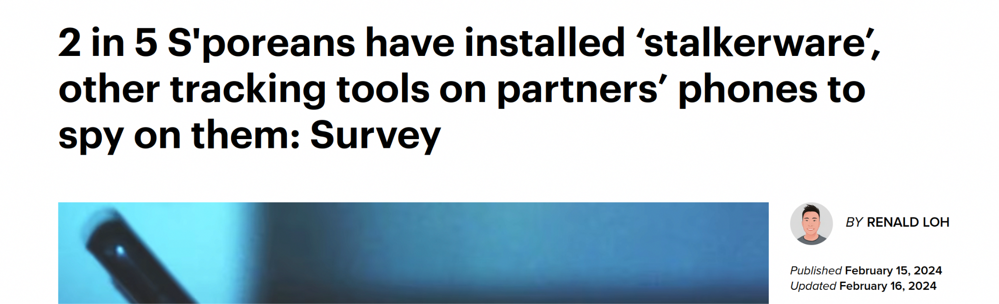
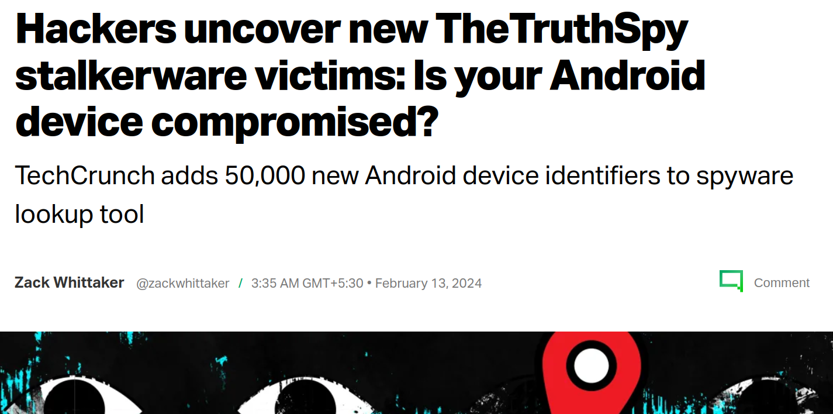
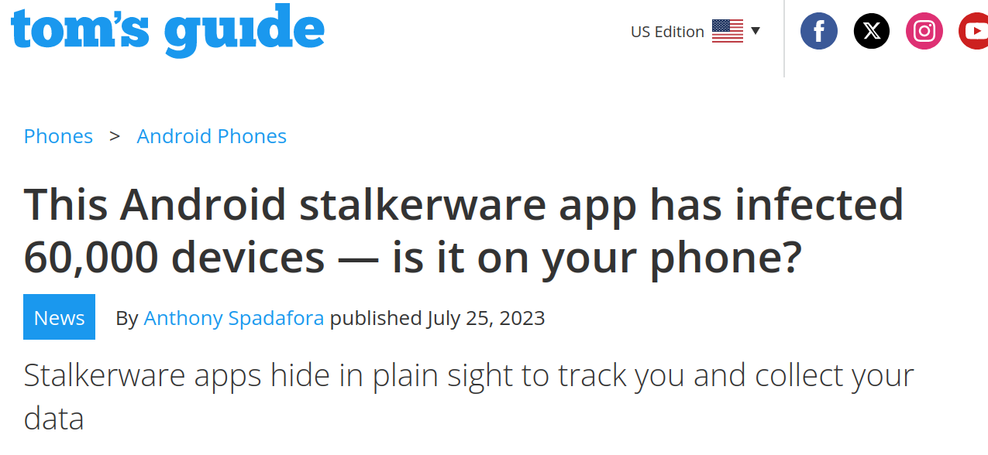
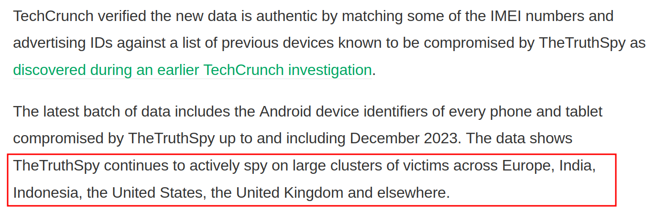
Stalkerware?

Slide 5
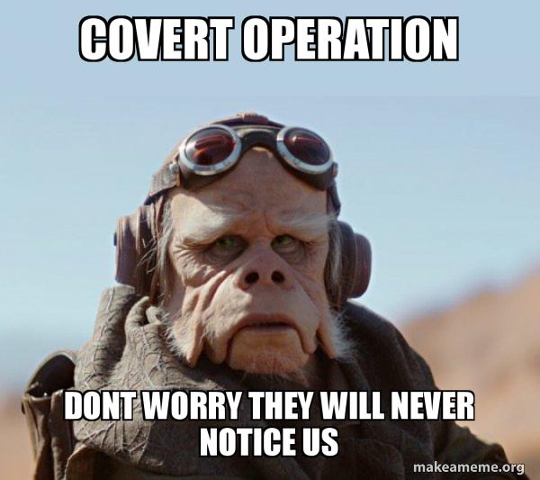
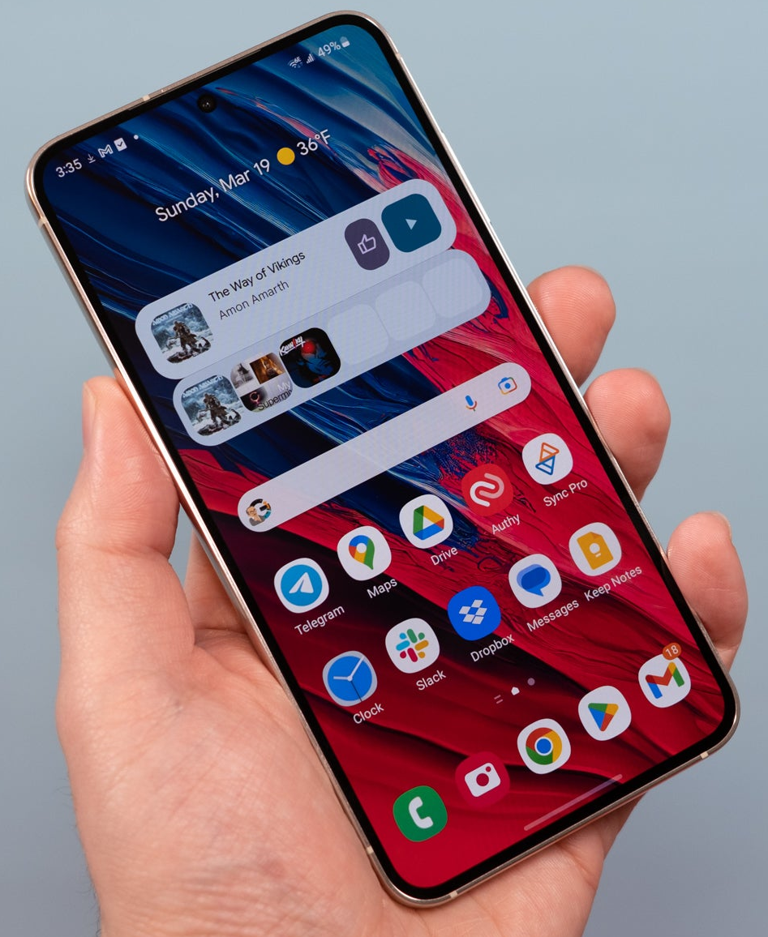

What is stalkerware?
Operate covertly on mobile devices to collect and monitor victim's communications and data
Need physical access to unlocked phone to be infected
"intimate partner surveillance" or IPS

Slide 6
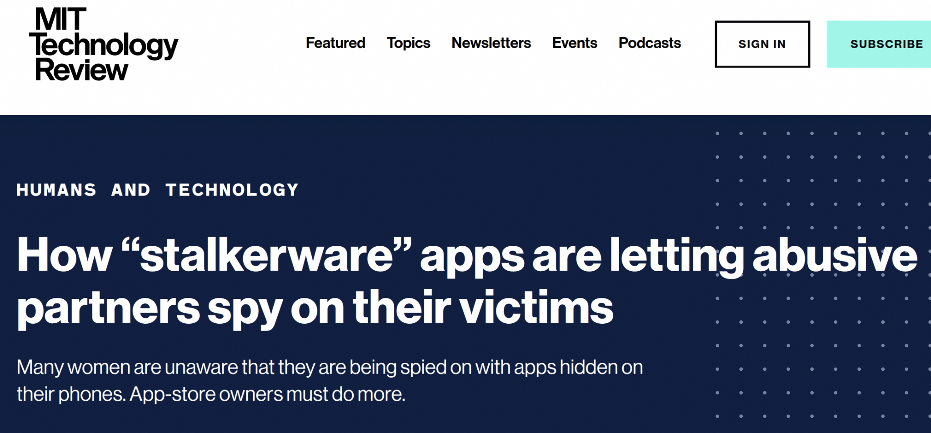
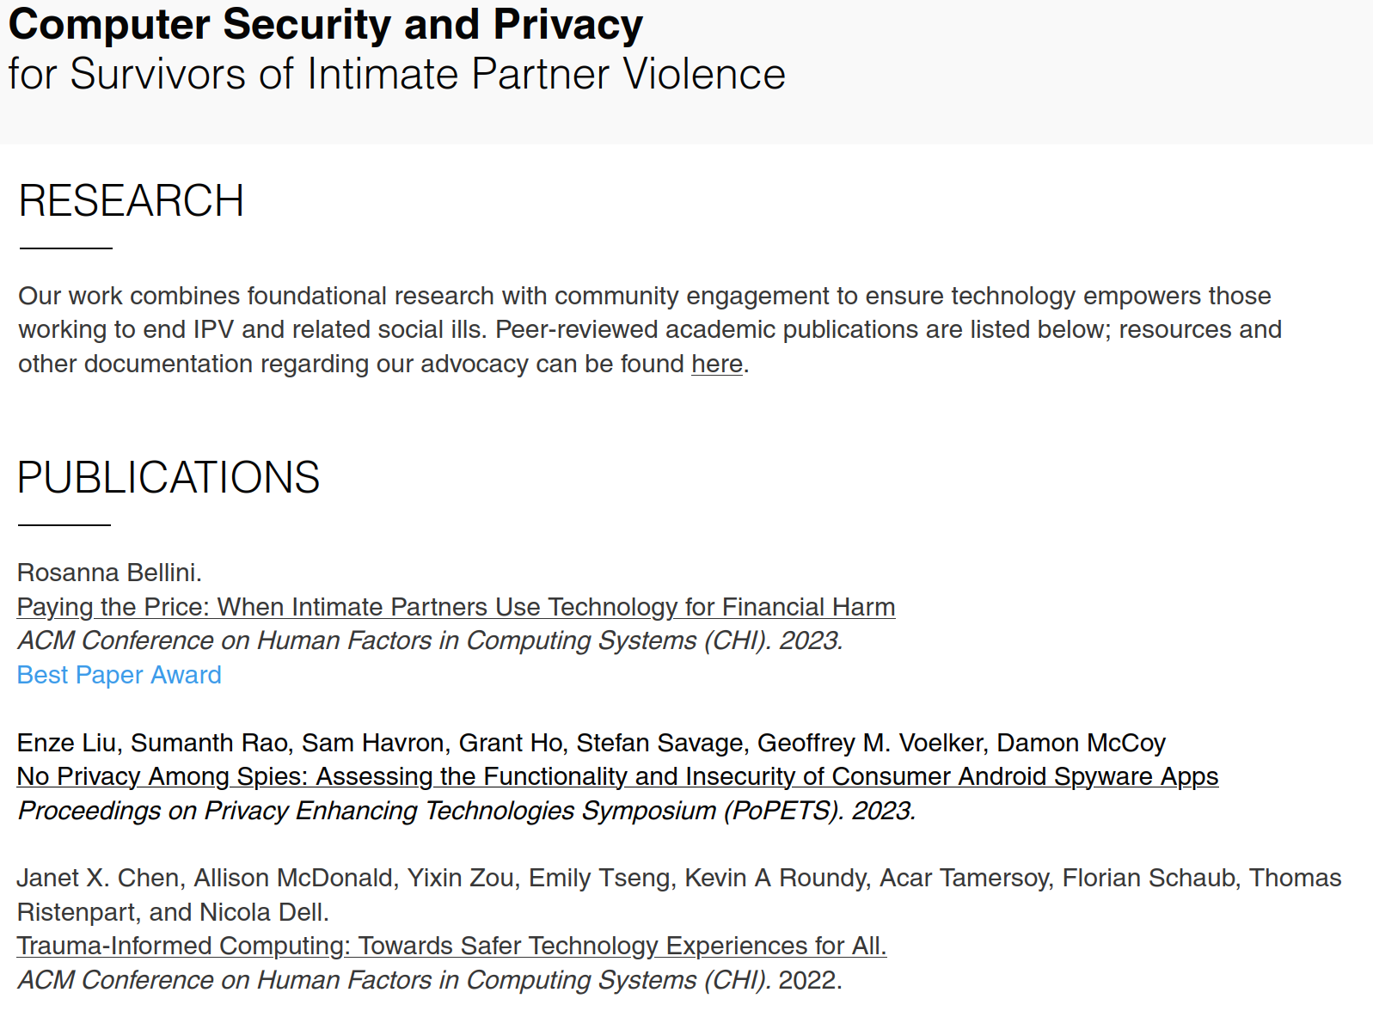
Cases of domestic violence reported
https://www.ipvtechresearch.org/research

Slide 7
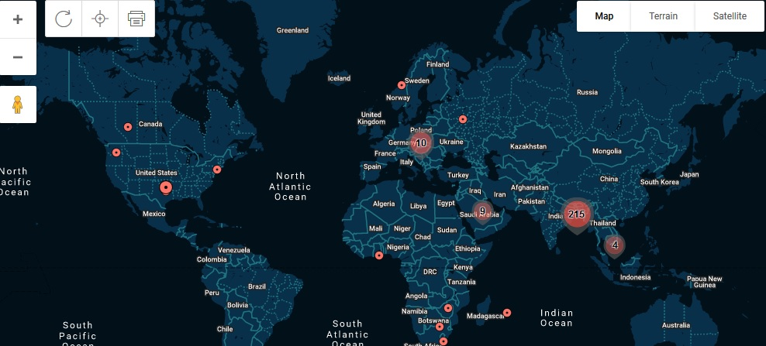
Who are the users?
**2016
https://github.com/diskurse/android-stalkerware

Slide 8
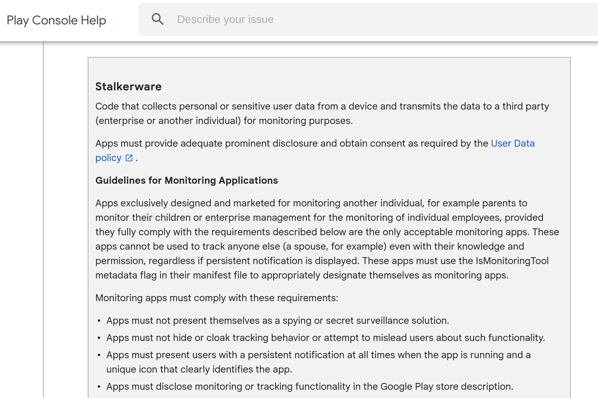

Fighting Stalkerware
Stricter policies for dual-use applications

Slide 9
Finding Stalkerwares
Known C2
Usage of Android Platform APIs
Static/Dynamic Analysis

Slide 10
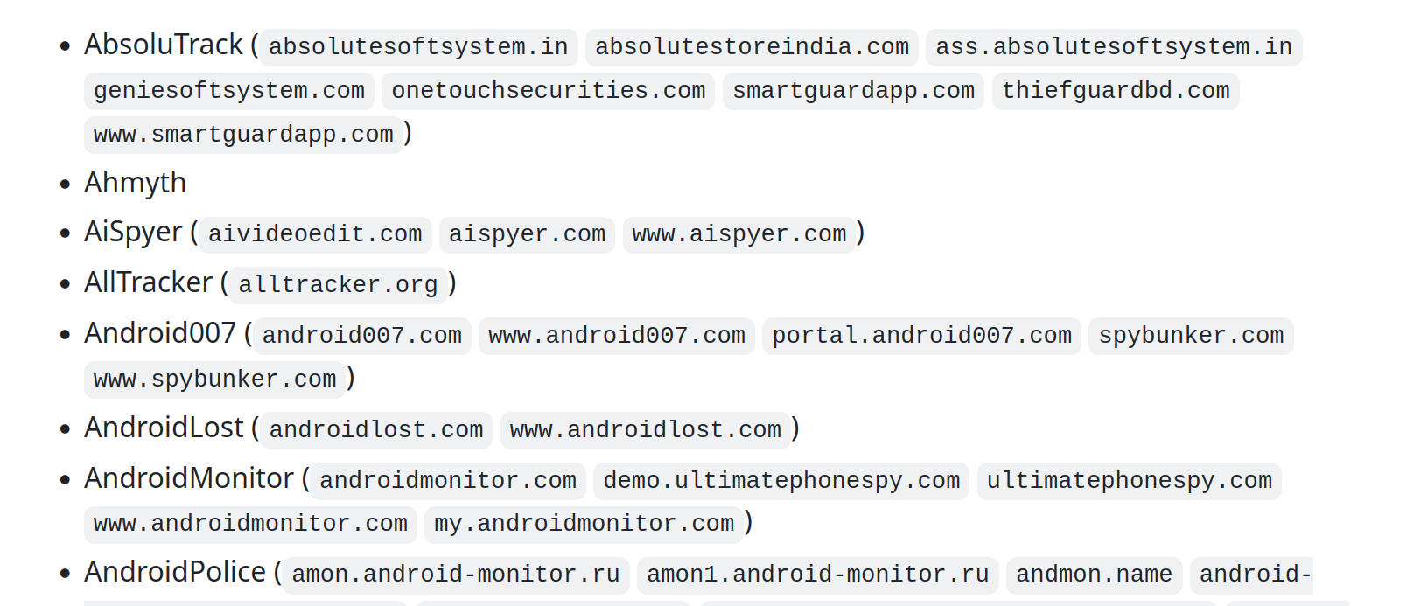
Indicators of Compromise (IOCs)
164 applications
Package names
Certificates
IP & host names of C2
https://github.com/AssoEchap/stalkerware-indicators

Slide 11
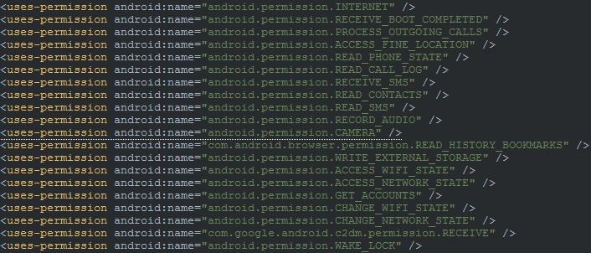
Permissions
'GET_ACCOUNTS' allows access to the list of accounts registered
'CAMERA' enables the app to covertly take photos or video
'RECORD_AUDIO' enables eavesdropping (the resulting video and audio files are uploaded to streaming services run by the stalkerware provider in some cases)
'ACCESS_FINE_LOCATION' access very precise location data from the victim's phone.

Slide 12
Platform API - Location
ACCESS_FINE_LOCATION
ACCESS_BACKGROUND_LOCATION if your app targets Android 10 (API level 29) or higher
LocationManager.GPS_PROVIDER: Determines location using satellites
LocationManager.NETWORK_PROVIDER: Determines location based on the availability of nearby cell towers and WiFi access points
LocationManager
getLatitude()
getLongitude()

Slide 13
Platform API
Accessibility Service
Device Admin
Remote commands
Screenshots
Take photo/video
Screenlock
Wipe device etc.
Hostile Downloaders

Slide 14

DEMO

Slide 15
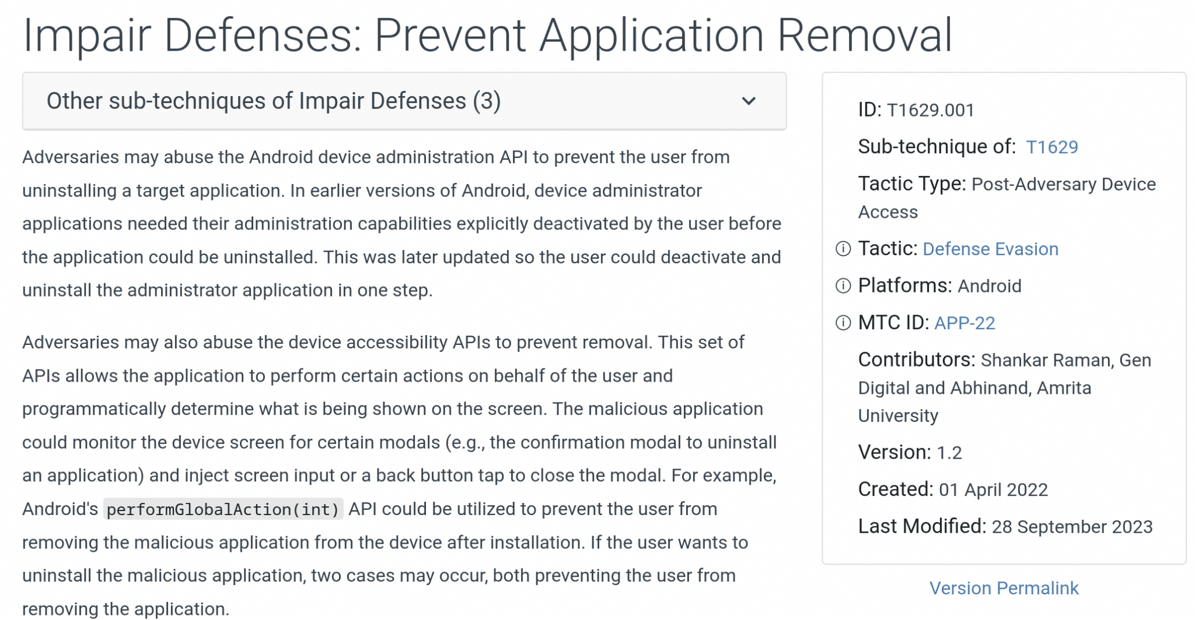
Impact
[1] https://attack.mitre.org/techniques/T1629/001/
[2] https://support.google.com/googleplay/android-developer/contact/policy_violation_report

